Slide 1
There is a season…..

Slide 2
There is a season…
Spring
Summer
Autumn
Winter

Slide 3
There is a mealtime…
Breakfast
Lunch
Tea
Dinner

Slide 4
There is a year…
School starts
Christmas
Birthday
Easter
Harvest
Tests/Exams
Holidays

Slide 5
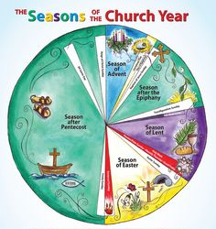
There is a church year season

Slide 6
There is a church year season
Preparation
Celebration
Consolidation

Slide 7
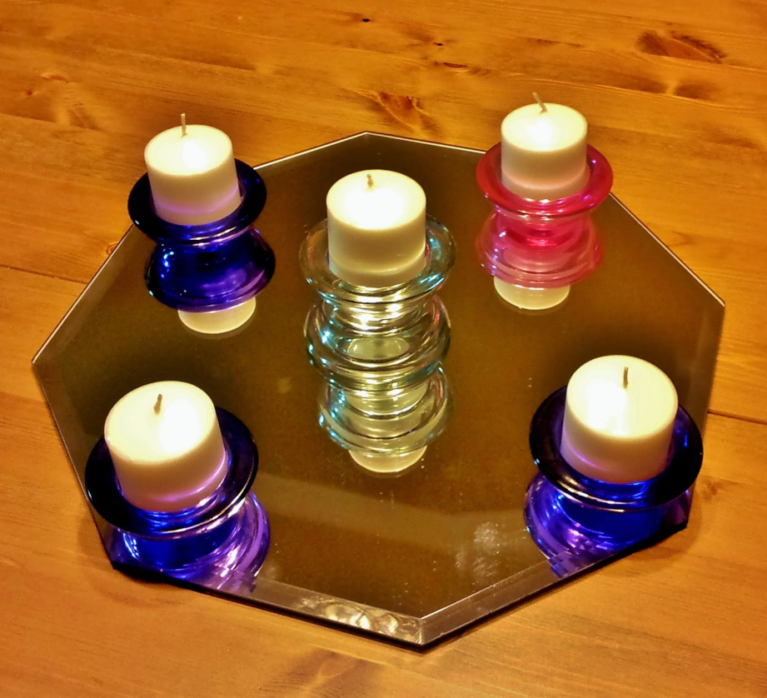
Advent
4 weeks
St Nicholas
Advent candles & calendars
Books of the story
The Jesse Tree
Building the crib
Prayers round the tree

Slide 8
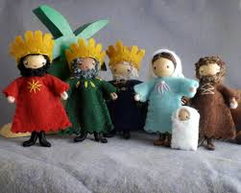
Christmas
Singing the story
Lighting the Christmas Tree
Adding the Christ Child
12 days of Christmas

Slide 9
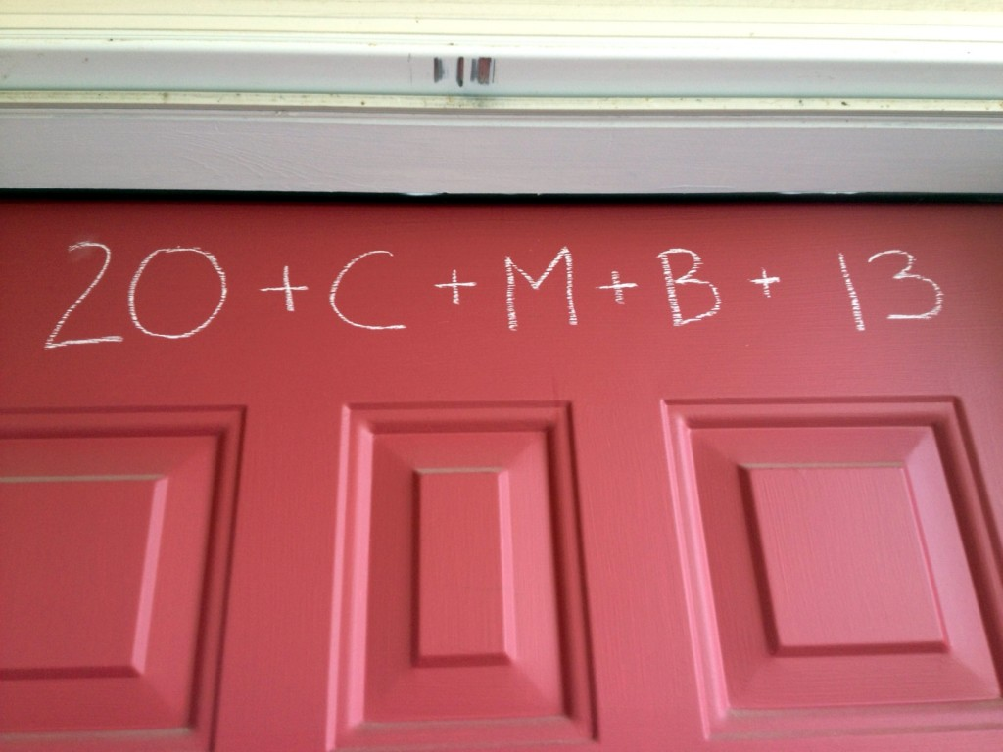
Epiphany
Magi reach the crib
Three Kings Cakes
Chalking of the doors
Taking down the tree
Celebrating baptism
Candlemas

Slide 10
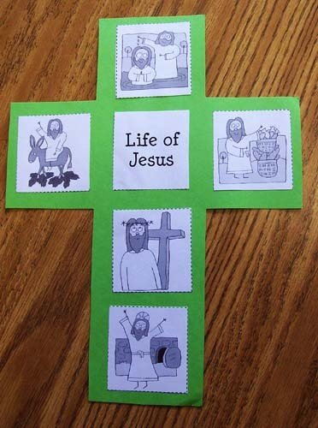
Ordinary Time Before Lent
Life stories
Bible bookcase
Valentine’s Day
Clearing out the clutter
Shrove Tuesday

Slide 11
Lent
6 weeks
Ash Wednesday
Jars of Grace
Love Life Live Lent
Lenten candles
Mothering Sunday
Eating simply
Walking through Holy Week
Exploring Holy Communion
Hot Cross Buns

Slide 12
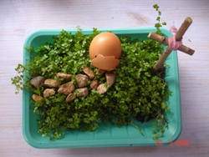
Easter
Creating an Easter Garden
Resurrection rolls
Easter Vigil
Making an Easter Tree – adding to it week by week

Slide 13
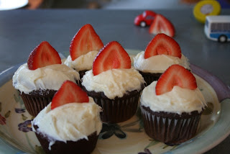
Pentecost
Wearing colours of fire
Pentecost cup cakes
The Lord’s Prayer in another language
Birthday of the church
Links with Christians across the world

Slide 14
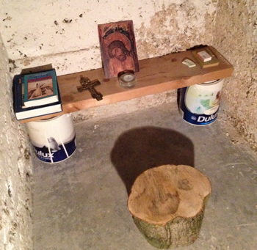
Ordinary Time
Creating ‘sacred space’
Symbols of the Gospel reading
Book/story of the week
Creating a prayer board
Harvest
Supporting mission
Exploring Saints
A time to remember

Slide 15
There is a rhythm…
Prayer
Bible
Worship
Action
Celebration

